Slide 1
Hotel Reservation Analysis with SQL

Slide 2
Objective-
This project showcases an analysis of a hotel reservation dataset using SQL.
The dataset provides insights into guest preferences, booking trends, and operational factors crucial for the hotel industry.
Each SQL query is designed to answer specific questions about the dataset, enabling deeper understanding and actionable insights.

Slide 3
Dataset overview-
The dataset includes information about reservations, guests, room types, and other relevant details.
We can extract meaningful information and can use it for calculating and for visualization
To get proper output and increase and drcrease in profit and revenue
Which can beneficial for near future for gathering and getting proper way of gaining profit.

Slide 4
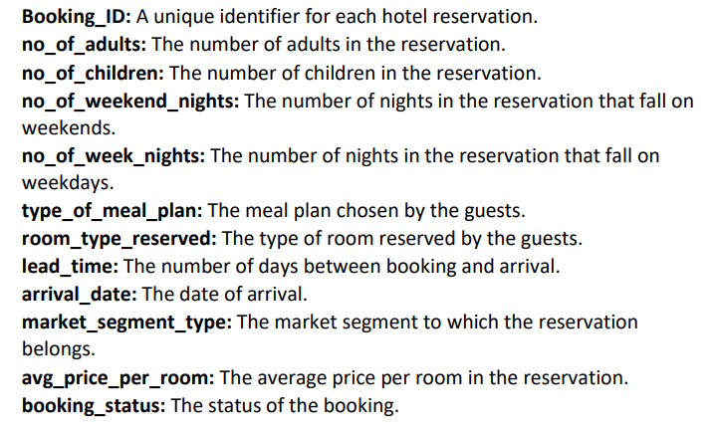
Dataset details-
Table- Hotel Reservation
Column-

Slide 5
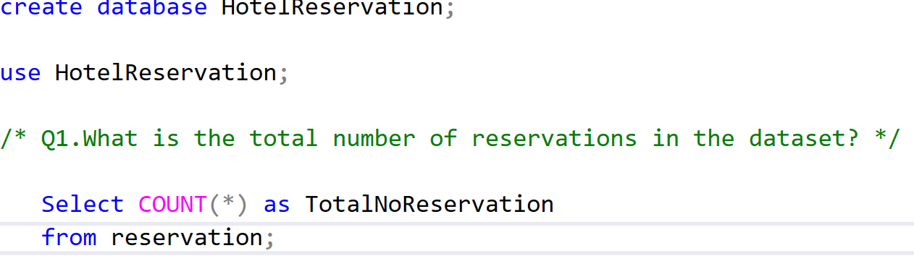

Q.1 Total number of reservation
— The total reservations made is 700.

Slide 6
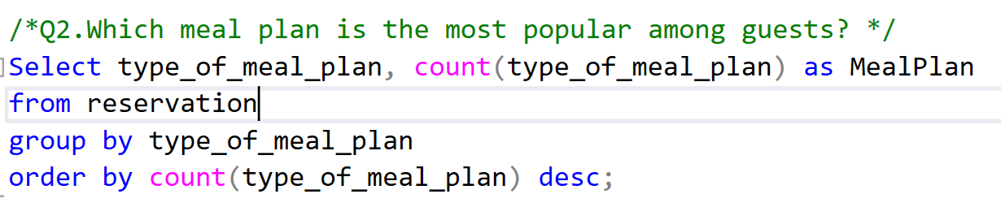
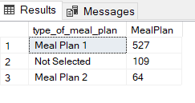
Q.2 meal plan is the most popular among guests
— The Most popular meal among the guest is MealPlan1 1.

Slide 7
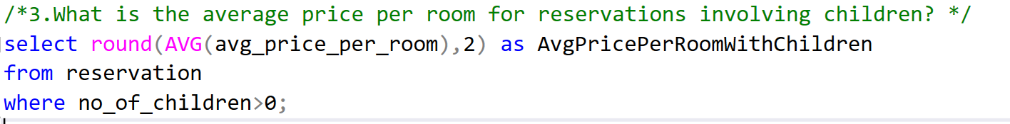

Q.3 average price per room for reservations involving children
— Average price is $144.57

Slide 8
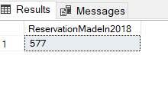
Q.4 reservations were made for the year 2018
— Total reservations made in 2018 is 577

Slide 9
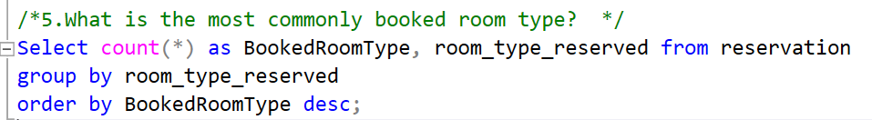
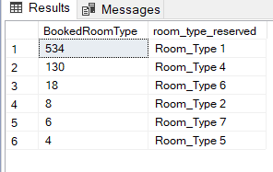
Q.5 most commonly booked room type
— The most commonly booked room type is
Room Type 1 with total reservations of 534.

Slide 10
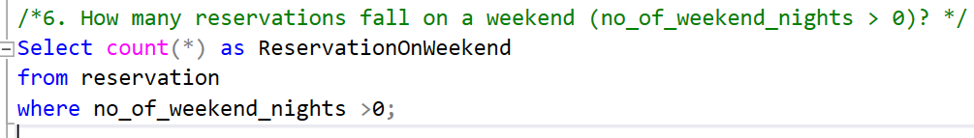

Q.6 reservations fall on a weekend
— Weekend reservations is 383

Slide 11
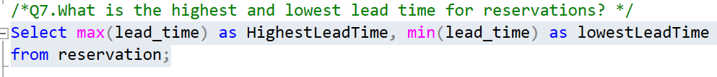

Q.7 highest and lowest lead time for reservations
— The highest lead time is 443 while the lowest
lead time is 0.

Slide 12
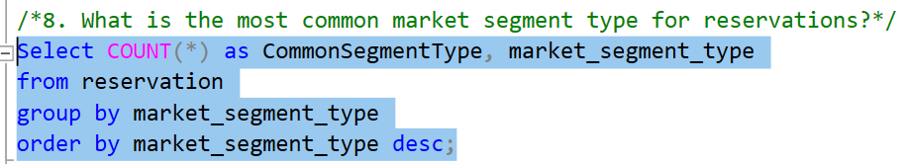
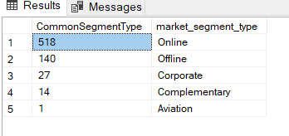
Q.8 most common market segment type for reservations
— Online with Total Reservations of 518

Slide 13
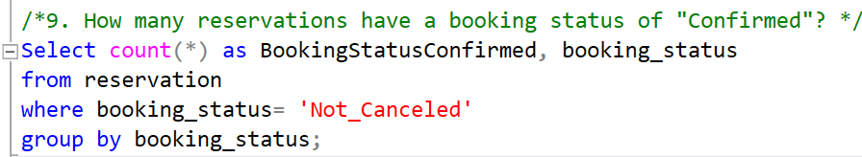

Q.9 reservations have a booking status of "Confirmed"
— Total confirmed booking status is 493

Slide 14
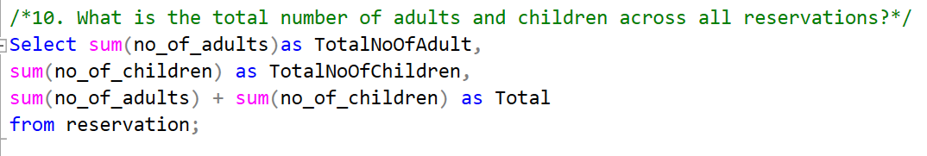

Q.10 total number of adults and children across all reservations

Slide 15
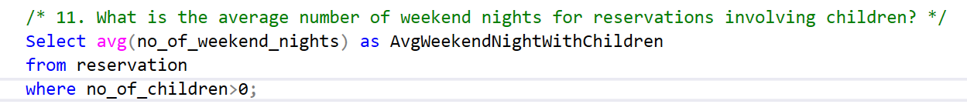

q.11 average number of weekend nights for reservations involving children
— Average weekend nights with Children is 1. This implies in every weekend reservation, the guests includes children.

Slide 16
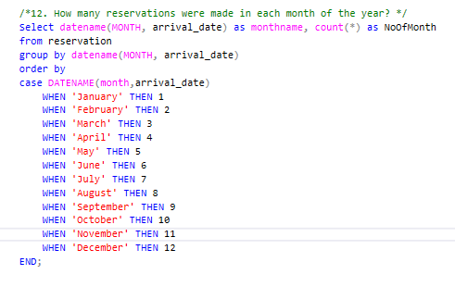
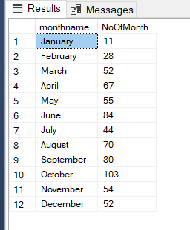
q.12 reservations were made in each month of the year
sd

Slide 17
Highest - October = 103 reservations
Lowest - January = 11 reservations
There is more reservation during Autumn compared to Winter season.

Slide 18
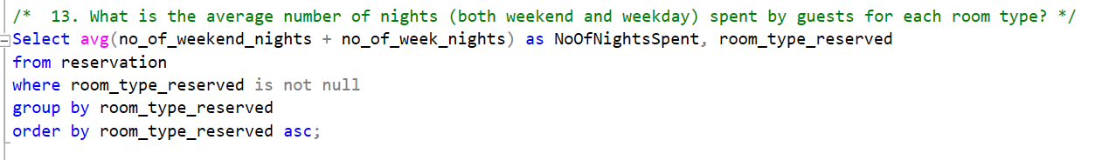
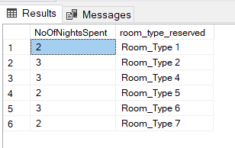
q. 13 average number of nights (both weekend and weekday) spent by guests for each room type
— The guests prefer the Room Type 4 and 6.

Slide 19
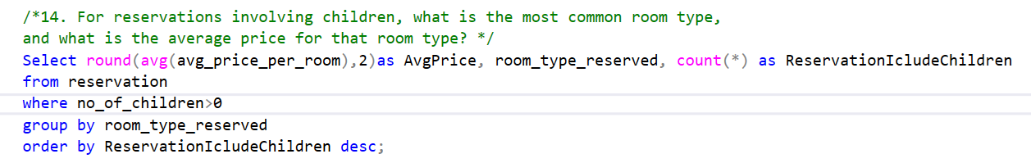
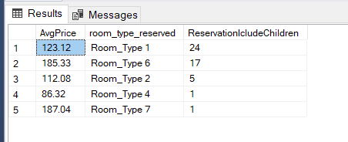
q.14 reservations involving children, what is the most common room type, and what is the average price for that room type

Slide 20
Room Type 1 with the highest number of reservations has an average price of $123.12.
Room Type 7 with the lowest number of reservations has an average price of $187.04 being the highest average price.
The number of reservations is not determinant to the price of room type.

Slide 21
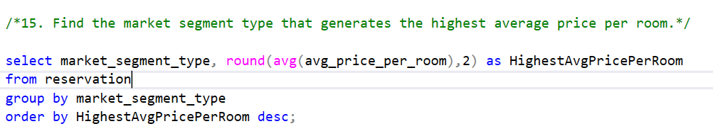
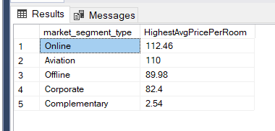
q.15 e market segment type that generates the highest average price per room
Online market segement with an average price per
room of $112.26

Slide 22
Conculsion-
Analysis provide valuable insight into guest preference and booking trend .
Key finding include meal plan 1 as the favoured choice among the guest, with room type 1 Being the most frequently booked.
Majority of reservation are confirmed,
market segment highlight online 125+, reflecting family friendly offerings.
The SQL queries cover various aspects of hotel reservation analysis, such as cancellation analysis, customer segmentation, and guest types
The goal is to gain insights into occupancy rates, revenue trends, and guest demographics, providing valuable information for hotel management.

